Slide 1
Using Bayesian Optimization in Pose Graphs Based SLAM 25th August
Zuxun Wang

Slide 2
Progress Since Last Meeting
Heatmap to better illustration of area that we interested.
Linear system performance check
AES paper 2D tracking example, try with 2 dof case.

Slide 3
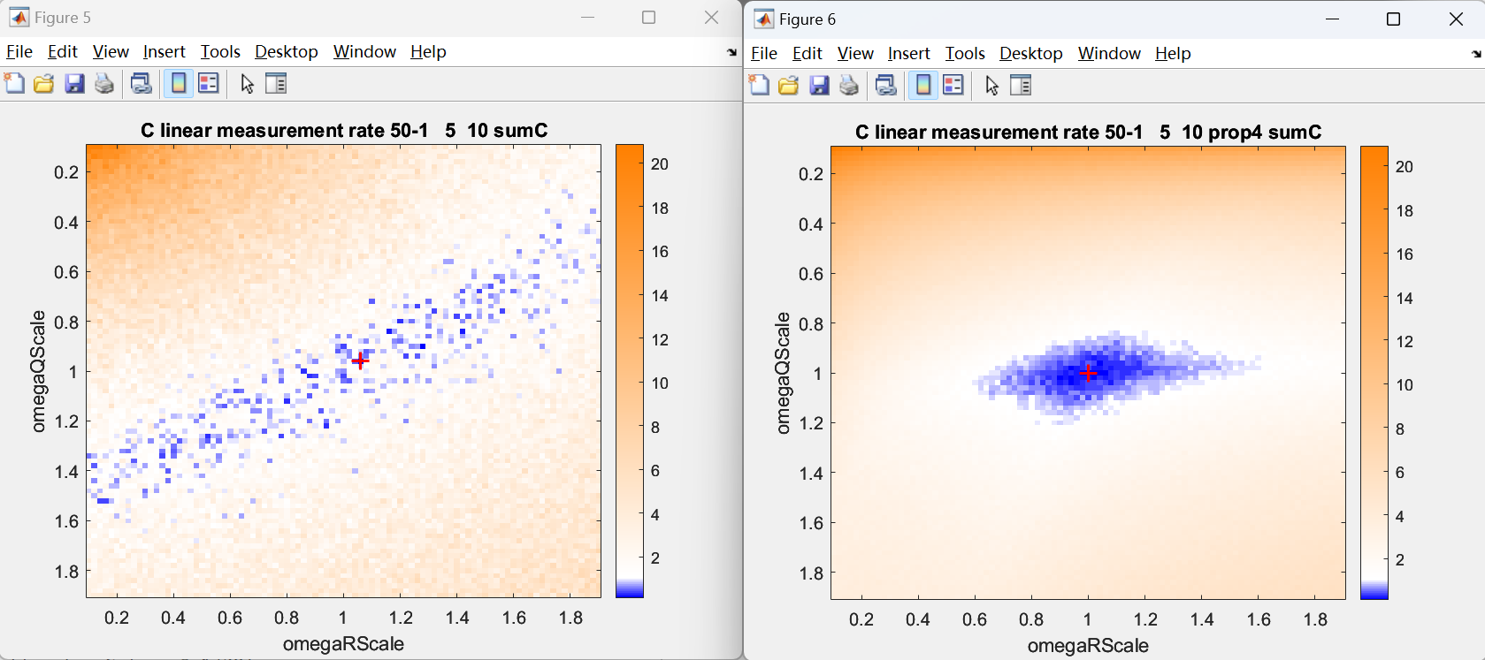
Linear System Heatmap(Left prop3, Right prop4)

Slide 4
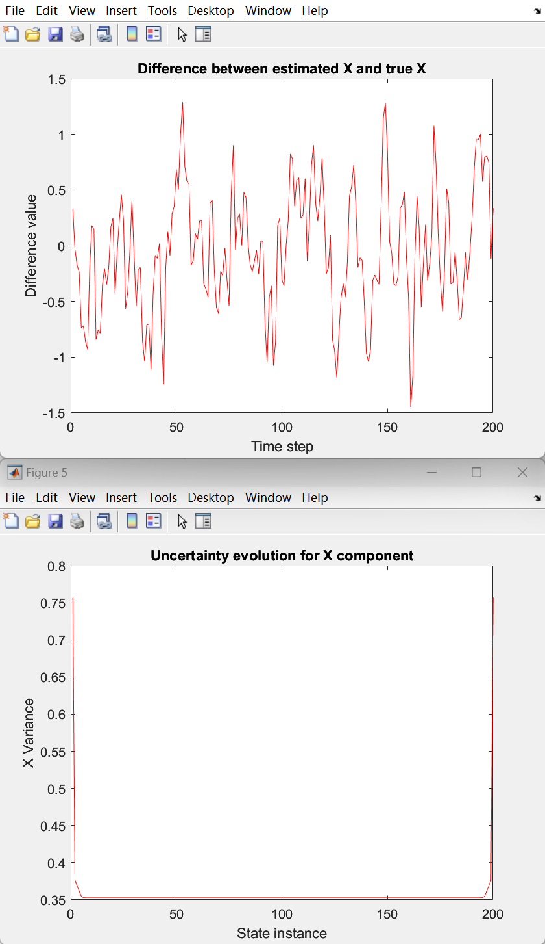
Linear System Performance Check (Optimal)
Total number of timestep: 200
Number of episodes: 1000
numObs: 50
obsPeriod: 1 (Every vertex has both process model edge and observation model edge connected)
omegaRScale: 1
omegaQScale: 1

Slide 5
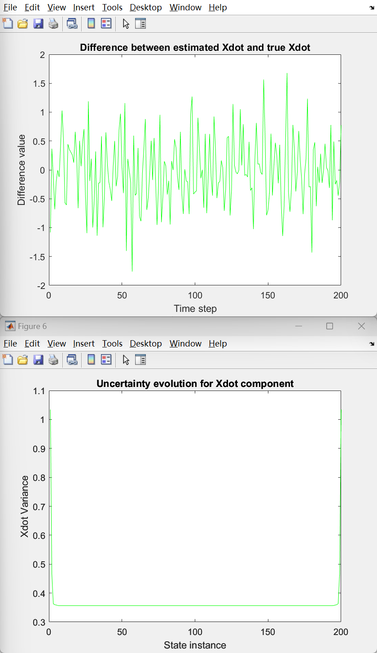
Linear System Performance Check (Optimal)
Total number of timestep: 200
Number of episodes: 1000
numObs: 50
obsPeriod: 1 (Every vertex has both process model edge and observation model edge connected)
omegaRScale: 1
omegaQScale: 1

Slide 6
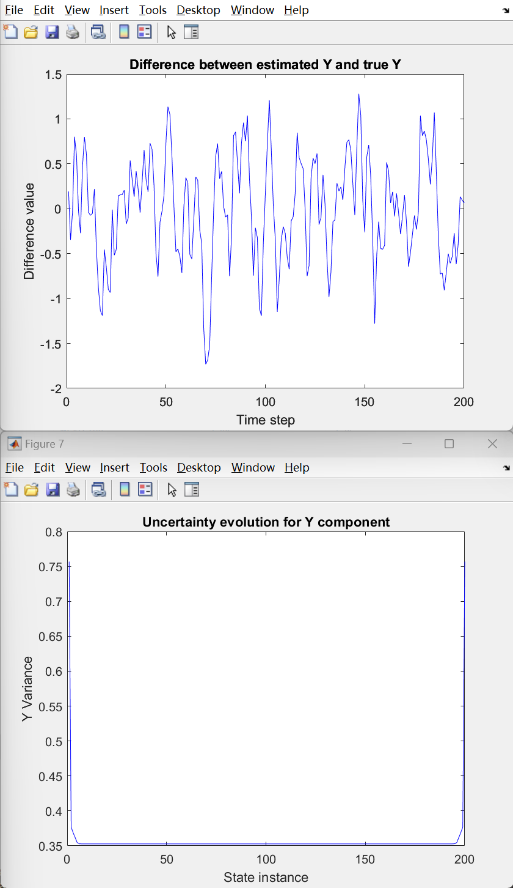
Linear System Performance Check (Optimal)
Total number of timestep: 200
Number of episodes: 1000
numObs: 50
obsPeriod: 1 (Every vertex has both process model edge and observation model edge connected)
omegaRScale: 1
omegaQScale: 1

Slide 7
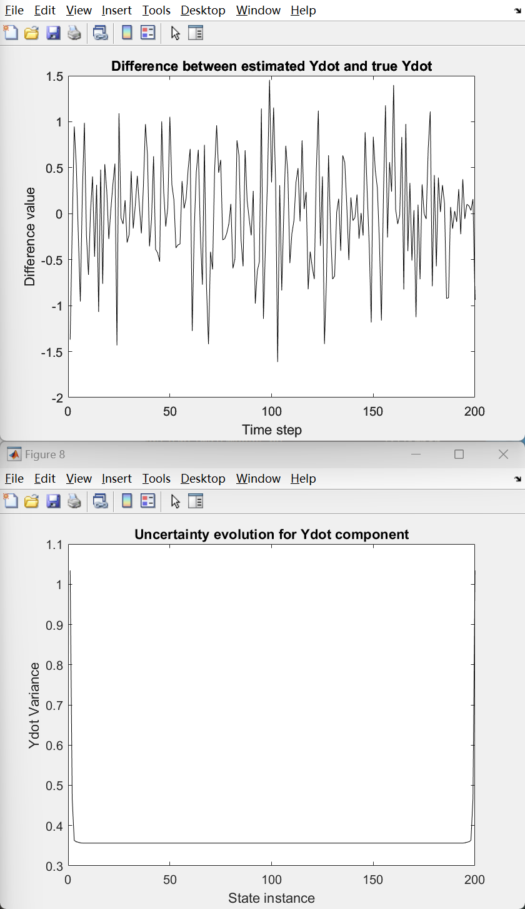
Linear System Performance Check (Optimal)
Total number of timestep: 200
Number of episodes: 1000
numObs: 50
obsPeriod: 1 (Every vertex has both process model edge and observation model edge connected)
omegaRScale: 1
omegaQScale: 1

Slide 8
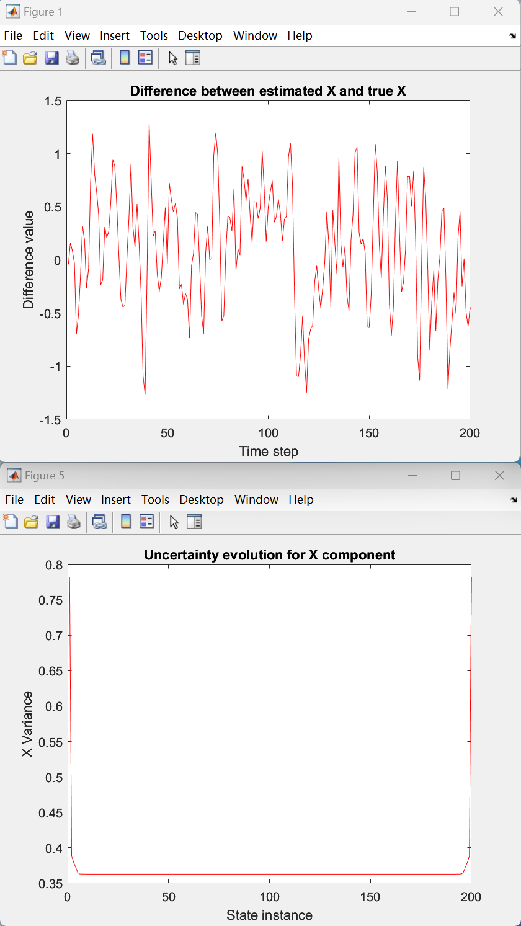
Linear System Performance Check (Test)
Total number of timestep: 200
Number of episodes: 1000
numObs: 50
obsPeriod: 1 (Every vertex has both process model edge and observation model edge connected)
omegaRScale: 0.96273
omegaQScale: 1.0016

Slide 9
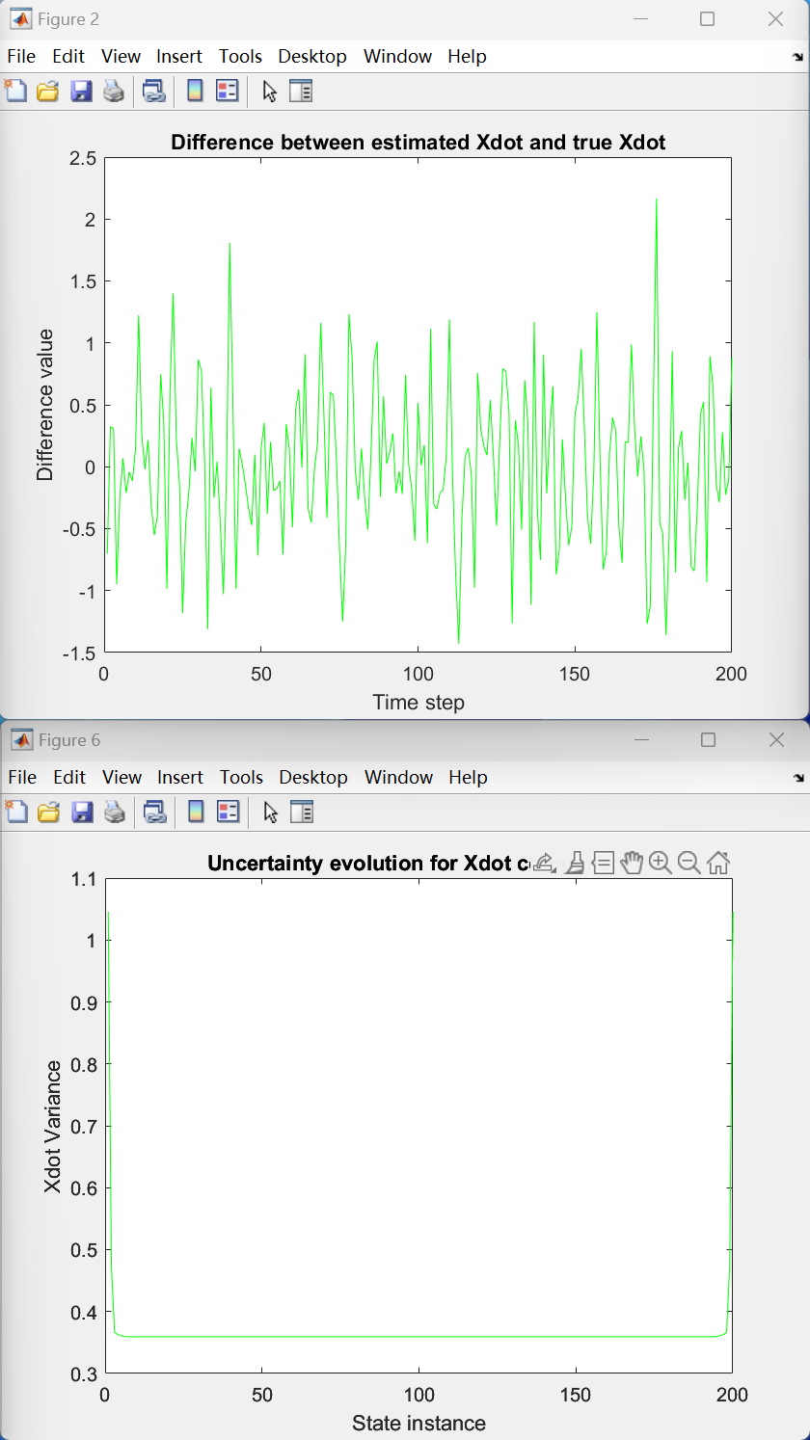
Linear System Performance Check (Test)
Total number of timestep: 200
Number of episodes: 1000
numObs: 50
obsPeriod: 1 (Every vertex has both process model edge and observation model edge connected)
omegaRScale: 0.96273
omegaQScale: 1.0016

Slide 10
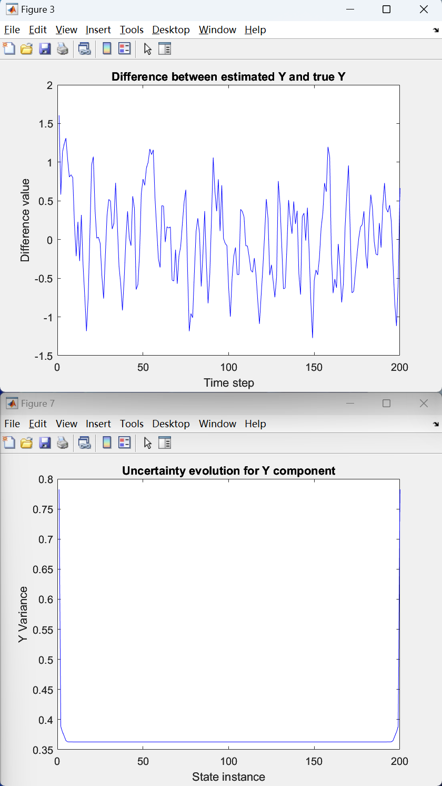
Linear System Performance Check (Test)
Total number of timestep: 200
Number of episodes: 1000
numObs: 50
obsPeriod: 1 (Every vertex has both process model edge and observation model edge connected)
omegaRScale: 0.96273
omegaQScale: 1.0016

Slide 11
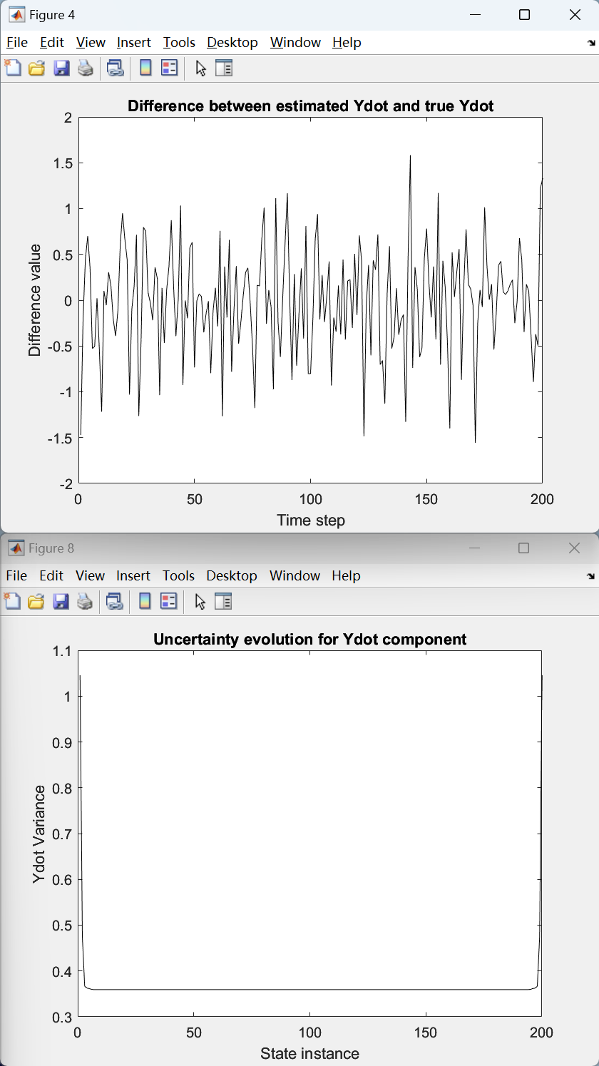
Linear System Performance Check (Test)
Total number of timestep: 200
Number of episodes: 1000
numObs: 50
obsPeriod: 1 (Every vertex has both process model edge and observation model edge connected)
omegaRScale: 0.96273
omegaQScale: 1.0016

Slide 12
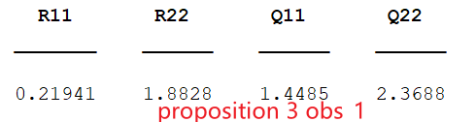
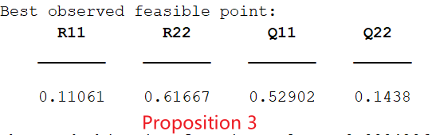
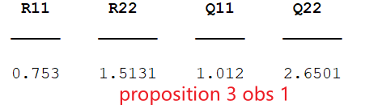
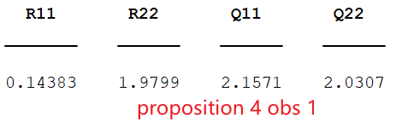
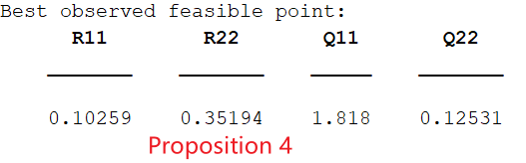
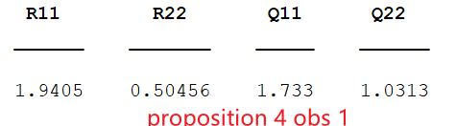
2D Tracking Example (2dof) Results
Total number of timestep: 200
Number of episodes: 1000
numObs: 50
obsPeriod: 1 (Every vertex has both process model edge and observation model edge connected)
Cost function: CNIS Value
Since I only test this scenario in a whole factor graph, the results seems to be bad (same as whole graph case in 1dof linear example). I’m wondering if using multiple subgraphs, the results would be better.

Slide 13
Problems / Issues
Is heatmap plots better for showing CNIS value?
The performance check results show that the optimal omega pairs have similar results with what we have using the omega values generated from bayesopt.
Does it mean that we could accept the bayesopt results?
Is there any other evaluation/validation metrics to exam omega values generated by bayesopt?

Slide 14
Planned Activities
Testing 2Dof scenario case with multiple subgraphs.
Continue working on the report.

